Slide 1
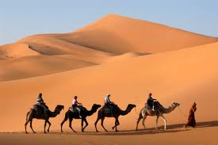
Welcome to Arabic II http://www.youtube.com/watch?v=w3wef_F_xvg&feature=player_detailpage Presented by Kurzban

Slide 2
Why learn Arabic?
Learning Arabic will be beneficial for the following reasons

Slide 3
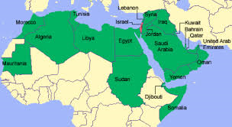
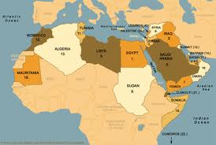
By Learning one language, you are able to open the door to 22 other Arabic countries

Slide 4
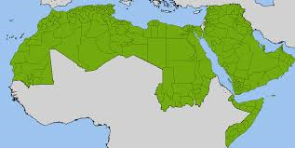
It’s the 5th commonly spoken language in the world

Slide 5
Arabic native speakers make up over 300 million people

Slide 6
Arabic is an official language at 4 international organizations

Slide 7
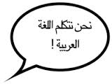
Arabic speakers are in big demand in the west

Slide 8
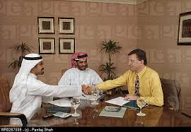
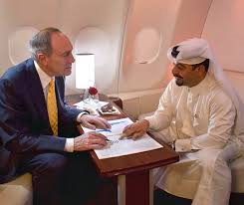
Americans who speak Arabic are in high demand; job opportunities are available in Arab countries

Slide 9
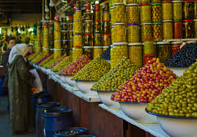
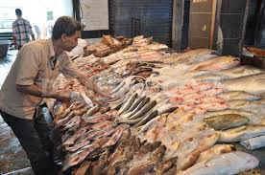
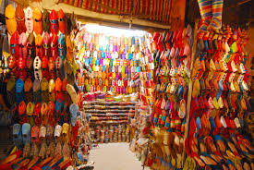
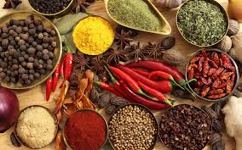
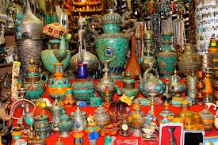
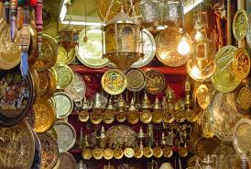
Understanding the culture and speaking the language will help you get better deals

Slide 10
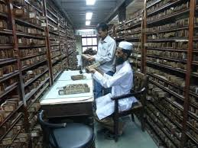
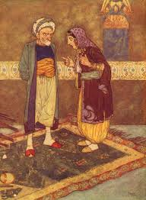
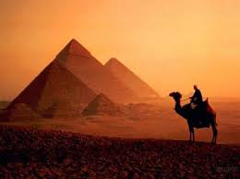
Arab contributions to civilizations
During the Dark Ages of Europe, much learning was preserved for the world through the Arab libraries in the universities of Morocco (Fez), Mali (Timbuktu) and Egypt (al-Azhar). From this period of Arab influence, new words such as orange, sugar, coffee, sofa, satin, and algebra filtered into the languages of Europe

Slide 11
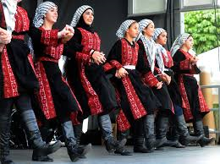
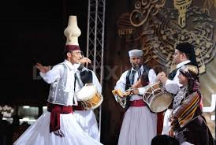
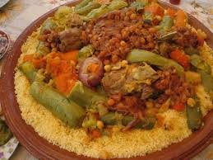
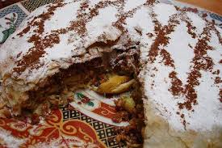
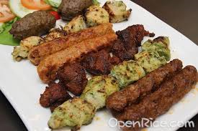
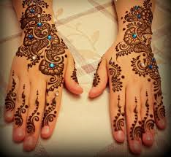
Appreciation of Arab food, music, culture, art & culture are worthy of understanding.

Slide 12
And lastly students need to study Arabic because it’s a college course that is worth 4 credits

Slide 13
Questions? Feed back!!
Email me @ skurzban@newpaltz.k12.ny.us

